Slide 1
Who is this Man Jesus?

Slide 2
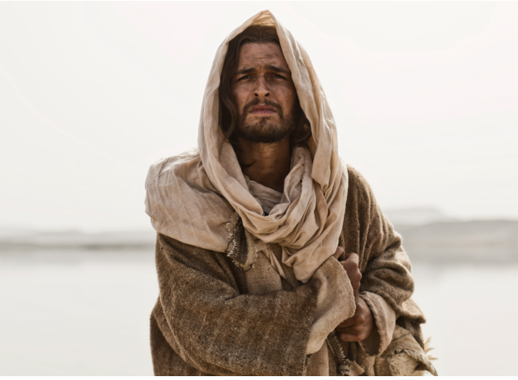
Who do Men Say that I Am?

Slide 3
Who do Men Say that I Am?
“A new survey reveals that 52 percent of American adults believe that Jesus was a great teacher and nothing more,” a Ligonier news release stated.
Even more surprising, “almost a third of evangelicals (30 percent) agree that Jesus was merely a great teacher.
And while 66 percent of American evangelicals disagree with the statement, ‘Jesus was a good teacher, but he was not God,’ nearly as many (65 percent) still agree with the statement, ‘Jesus is the first and greatest being created by God.’”

Slide 4
Who Believes He Actually Lived?

Slide 5
Who do Men Say that I Am?
Matthew 16:13-18
John the Baptist
Elijah
Jeremiah
Another Prophet

Slide 6
What are the Implications if Jesus was simply a Great Teacher
(or Prophet) ?

Slide 7
Famous Christian apologist—not to mention former atheist—C.S. Lewis answered in this way: “A man who was merely a man and said the sort of things Jesus said would not be a great moral teacher. He would either be a lunatic—on a level with the man who says he is a poached egg—or else he would be the Devil of Hell. You must make your choice.”¹

Slide 8
Jesus IS God
In the beginning was the Word, and the Word was with God, and the Word was God. He was in the beginning with God.
All things came into being through Him, and apart from Him nothing came into being that has come into being. John 1:1-3

Slide 9
Jesus IS God
In the beginning was the Word, and the Word was with God, and the Word was God. He was in the beginning with God.
All things came into being through Him, and apart from Him nothing came into being that has come into being. John 1:1-3
When was the beginning?

Slide 10
Jesus IS God
In the beginning was the Word, and the Word was with God, and the Word was God. He was in the beginning with God.
All things came into being through Him, and apart from Him nothing came into being that has come into being. John 1:1-3
When was the beginning?
Co-Existed w God

Slide 11
Jesus IS God
In the beginning was the Word, and the Word was with God, and the Word was God. He was in the beginning with God.
All things came into being through Him, and apart from Him nothing came into being that has come into being. John 1:1-3
When was the beginning?
Co-Existed w God
He was GOD!

Slide 12
Jesus IS God
In the beginning was the Word, and the Word was with God, and the Word was God. He was in the beginning with God.
All things came into being through Him, and apart from Him nothing came into being that has come into being. John 1:1-3
When was the beginning?
Co-Existed w God
He was GOD!
He created this world and everything in it

Slide 13
What is The Godhead?

Slide 14
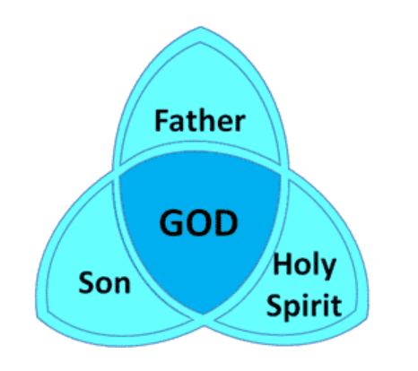
The Trinity – Godhead

Slide 15
Next -> Jesus WAS GOD among US
And the Word became flesh and dwelt among us, and we beheld His glory, the glory as of the only begotten of the Father, full of grace and truth. John 1:14

Slide 16
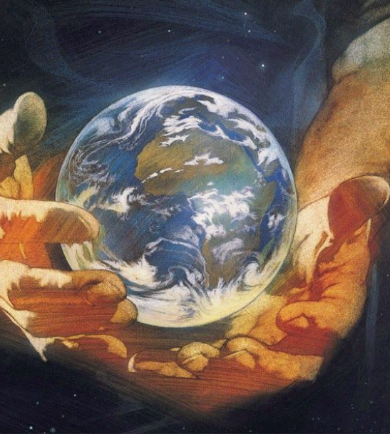
Jesus became
GOD INCARNATE

Slide 17
What is INCARNATE?
Have this attitude in yourselves which was also in Christ Jesus, who, although He existed in the form of God, did not regard equality with God a thing to be grasped, but emptied Himself, taking the form of a bond-servant, and being made in the likeness of men. Being found in appearance as a man, He humbled Himself by becoming obedient to the point of death, even death on a cross. Phil. 2:6-8

Slide 18
“Behold, the virgin shall be with child, and bear a Son, and they shall call His name “Immanuel,” which is translated, “God with us.”” Matthew 1:23
Most people don’t believe Jesus was God living among humans

Slide 19
Jesus was two mutually exclusive things at the same time.
His deity did not make His humanity superhuman and His humanity did not make His deity diminished to a lesser god.

Slide 20
Why is it important that Jesus was both God & Man?

Slide 21
Fully God & Fully Human
If only God – he could not have paid the price of blood for mankind.
If only Man – he could not have revealed God to us.

Slide 22
What did Jesus Say about Himself?
John 6:35
John 18:37
John 14:5-6

Slide 23
John 6
30 Therefore they said to Him, “What sign will You perform then, that we may see it and believe You? What work will You do? 31 Our fathers ate the manna in the desert; as it is written, ‘He gave them bread from heaven to eat.’ ”
32 Then Jesus said to them, “Most assuredly, I say to you, Moses did not give you the bread from heaven, but My Father gives you the true bread from heaven. 33 For the bread of God is He who comes down from heaven and gives life to the world.”
What did Jesus Say about Himself?
John 6:35
John 18:37
John 14:5-6

Slide 24
John 18
33 Then Pilate entered the Praetorium again, called Jesus, and said to Him, “Are You the King of the Jews?”
34 Jesus answered him, “Are you speaking for yourself about this, or did others tell you this concerning Me?”
35 Pilate answered, “Am I a Jew? Your own nation and the chief priests have delivered You to me. What have You done?”
36 Jesus answered, “My kingdom is not of this world. If My kingdom were of this world, My servants would fight, so that I should not be delivered to the Jews; but now My kingdom is not from here.”
37 Pilate therefore said to Him, “Are You a king then?”
Jesus answered, “You say rightly that I am a king. For this cause I was born, and for this cause I have come into the world, that I should bear witness to the truth. Everyone who is of the truth hears My voice.”
What did Jesus Say about Himself?
John 6:35
John 18:37
John 14:5-6

Slide 25
What did Jesus Say about Himself?
John 14
Let not your heart be troubled; you believe in God, believe also in Me.
2 In My Father’s house are many mansions; if it were not so, I would have told you. I go to prepare a place for you.
3 And if I go and prepare a place for you, I will come again and receive you to Myself; that where I am, there you may be also.
4 And where I go you know, and the way you know.”
5 Thomas said to Him, “Lord, we do not know where You are going, and how can we know the way?”
6 Jesus said to him, “I am the way, the truth, and the life. No one comes to the Father except through Me.
John 6:35
John 18:37
John 14:5-6

Slide 26
What did Paul Say about Jesus?
Now, therefore, you are no longer strangers and foreigners, but fellow citizens with the saints and members of the household of God, having been built on the foundation of the apostles and prophets, Jesus Christ Himself being the chief cornerstone, in whom the whole building, being fitted together, grows into a holy temple in the Lord, in whom you also are being built together for a dwelling place of God in the Spirit. Eph. 2:19-22

Slide 27
What is a Cornerstone?

Slide 28
What is a Cornerstone?
Jesus said to him, “I am the way, the truth, and the life. No one comes to the Father except through Me. John 14:6

Slide 29
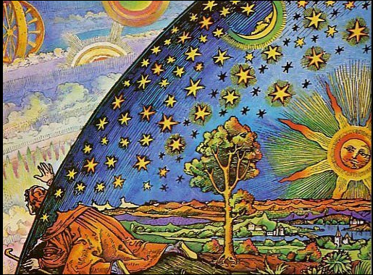
What is Gnosticism?

Slide 30
Gnostics believed that all flesh is evil and that only spirit is good. Because they believed that, they didn't believe that Jesus really came in the flesh - they believed He was an illusion. They also believed that because sin had to do with our flesh, there really wasn't sin - sin was also just an Illusion.
Gnosticism: False Doctrine

Slide 31
The majority Gnostic position was one that modern scholars call “separationism:” the idea that Jesus did have a material body, but that his body and his spirit were two separate entities, it never suffered.
This made perfect sense within the Gnostics’ sharply dualistic worldview, wherein spirit and matter were categorically different, and even opposing, phenomena.
Gnosticism: False Doctrine

Slide 32
Witnesses
This is He who came by water and blood—Jesus Christ; not only by water, but by water and blood. And it is the Spirit who bears witness, because the Spirit is truth. For there are three that bear witness in heaven: the Father, the Word, and the Holy Spirit; and these three are one. And there are three that bear witness on earth: the Spirit, the water, and the blood; and these three agree as one. 1 John 5:6-8

Slide 33
Philippians 2:5-10
“5 Let this mind be in you which was also in Christ Jesus, 6 who, being in the form of God, did not consider it robbery to be equal with God, 7 but made Himself of no reputation, taking the form of a bondservant, and coming in the likeness of men.
8 And being found in appearance as a man, He humbled Himself and became obedient to the point of death, even the death of the cross.
9 Therefore God also has highly exalted Him and given Him the name which is above every name, 10 that at the name of Jesus every knee should bow, of those in heaven, and of those on earth, and of those under the earth, 11 and that every tongue should confess that Jesus Christ is Lord, to the glory of God the Father..”

Slide 34
What was Jesus’ Purpose?
John 6:38
Mark 10:45
1 Tim 1:15
John 12:46-47
Col 1:19-20

